Slide 1

Solar Panel and Inverter Monitoring System with Mobile Application (FYP III)
Project ID: E2018
PRESENTED BY:
Muhammad Haseeb (200718)
Syed Muhammad Usama Bin Aqil(200758)
Rao Umer Rashid (200776)
SUPERVISOR:
Dr. Muhammad Zaheer

Slide 2
Presentation Overview
Introduction
Literature Review & Problem Statement
Detailed Methodology
Project Flowchart / Diagram
Achievements / Completed Tasks
Project Deliverables Status
Cost Analysis
Conclusion
References

Slide 3
Introduction
Design and Implementation of a Solar-Powered Inverter System.
Real-time Monitoring Through Mobile Application.
Providing Insight to the System Performance/Graphical Representation.
Alert Notifications to assist in Diagnostics.

Slide 4
Literature Review
References | Description
International Renewable Energy Agency. (2021) | Solar photovoltaic (PV) technology dominates the solar energy market, accounting for about 90% of the total solar capacity installed worldwide.
Majhi, Bijoyprakash. "Analysis of single-phase SPWM inverter." PhD diss., 2012. | PWM (Pulse Width Modulation) Technique is widely adopted for the Construction of Inverters
Kumar, Aishwarya, et al. "An IOT based smart inverter." 2016 IEEE International Conference on Recent Trends in Electronics, Information & Communication Technology (RTEICT). IEEE, 2016. | There is a sudden emergence of smart inverters with communication capabilities to record and display data

Slide 5
Problem Statement
Develop a comprehensive solution to address the current energy crisis caused by scarce resources, focusing on promoting the utilization of renewable energy sources. The solution should aim to mitigate the increasing electricity costs and prevent a decline in the standard of living. Additionally, design a monitoring system that is readily accessible to track energy usage and promote efficient resource management.

Slide 6
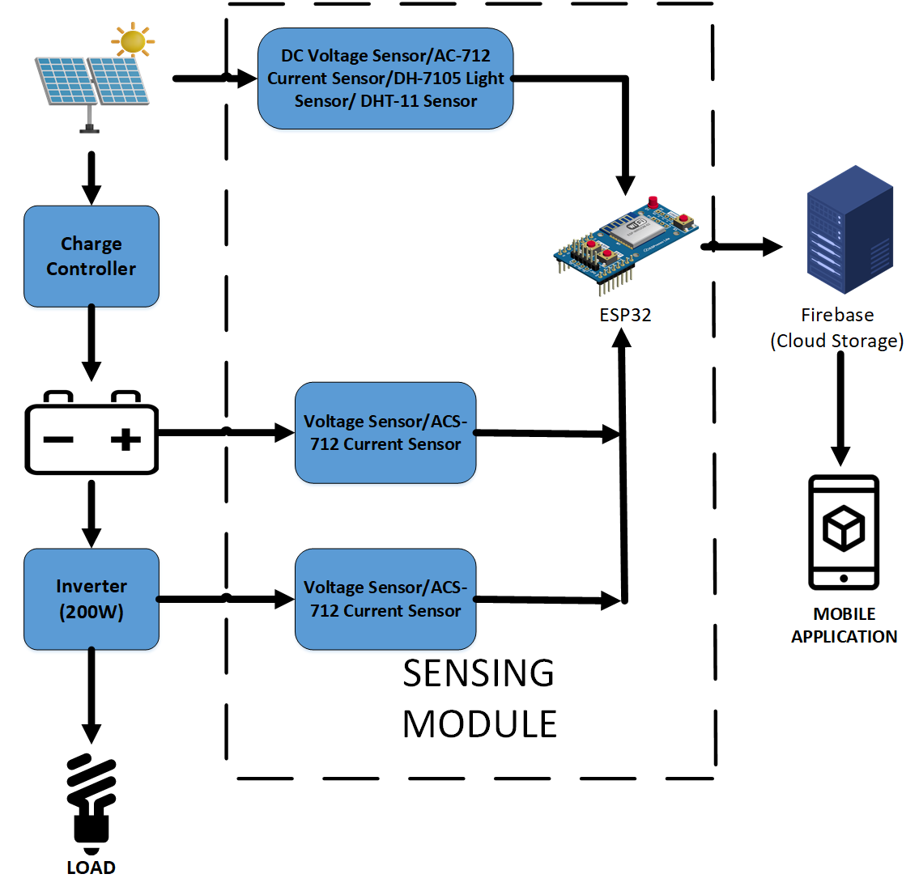
Detailed Methodology

Slide 7
Detailed Methodology
DESIGN PARAMETERS
PV Panel | 30 Watt : 18Vmax , 1.6Amax
Battery | 12V, 7Ah
Inverter | 200 Watt
Transformer | 12 to 220v , 6Amp
Current Sensor (ACS 712) | 5 Amp

Slide 8
Detailed Methodology
Components Used
ACS 712 | Current Sensor
Arduino Nano | Variable PWM, LCD Interfacing, And Data Display
Esp32 | Data Logging and Data Communication With Cloud
Mosfet (IRF 250) | Switching at High Speeds
IC CD 4047 | Generates a fixed PWM, 50 Hz
LM 7809 | Provides 9 Volts
DHT11 | Humidity/Temp Sensor
DH1750 | Light Sensor

Slide 9
Detailed Methodology
Functionality Explained
PV Panels
Provides Input DC Power
Charge Controller
Voltage Regulation for Safe Charging
Optimum Charging Voltage
Usage of Buck Converter

Slide 10
Detailed Methodology
Functionality Explained
Sensing Module
Senses Change in AC/DC Power
Interfaced with Inverter/PV Panel/Battery
ESP32 Used for Data Detection and Calibration
Communicates Data with Fire-Base
Battery
Provides Steady flow of DC Power to Inverter

Slide 11
Detailed Methodology
Functionality Explained
Inverter
Uses Fixed PWM at 50 Hz using CD4047
Push Pull Configuration
Transformer Steps Up 12-volt AC to 220-volts
Load
Load is Powered using the Inverter

Slide 12
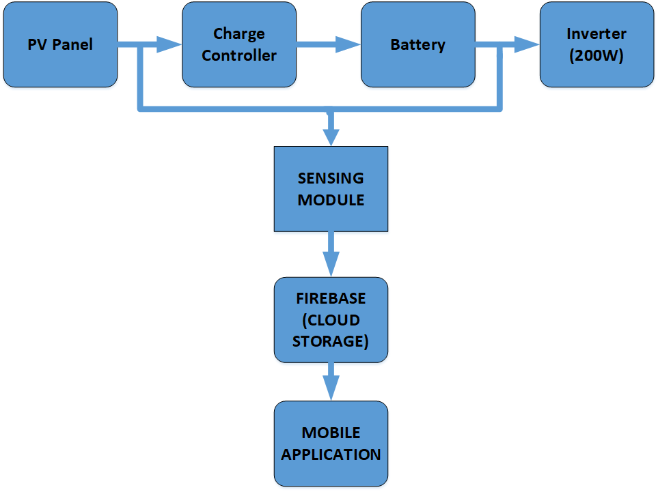
Project Flow Diagram

Slide 13
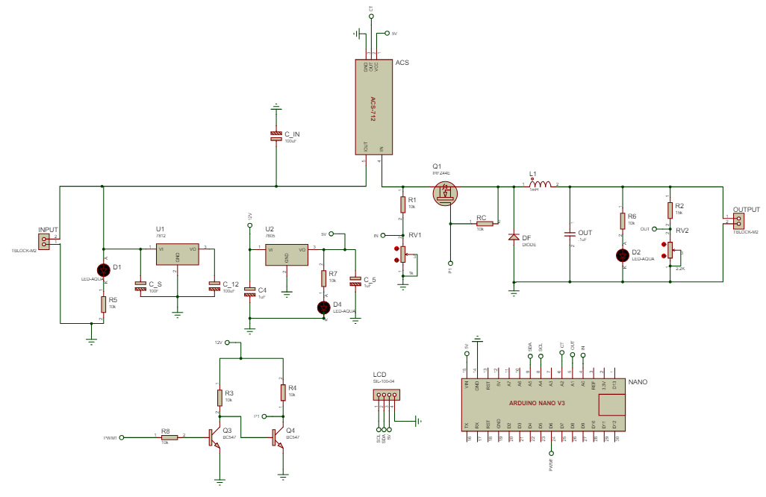
Circuit Diagrams
Charge
Controller

Slide 14
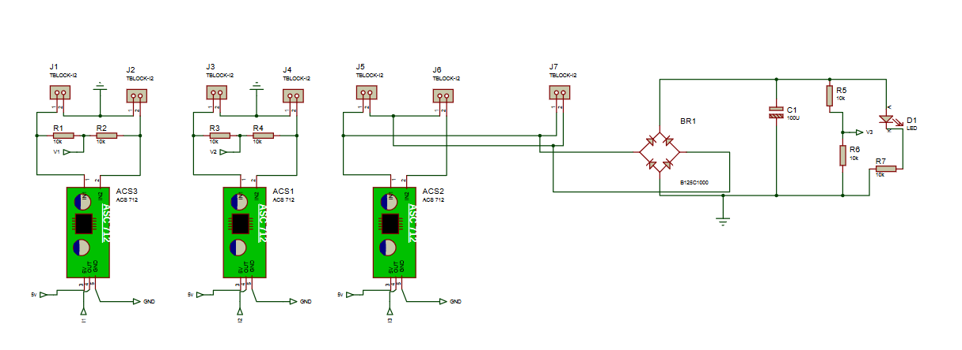
Circuit Diagrams
Sensing Module

Slide 15
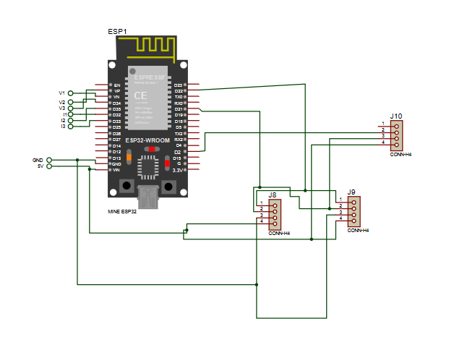
Circuit Diagrams
Sensing Module (contd.)

Slide 16
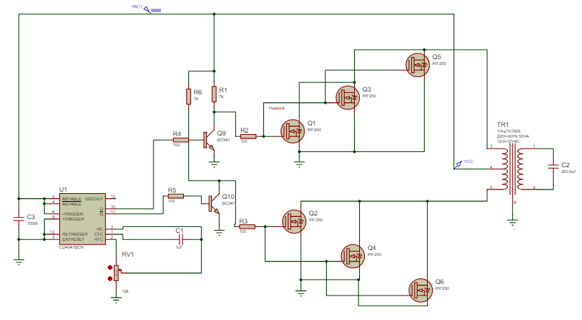
Circuit Diagram
Inverter

Slide 17
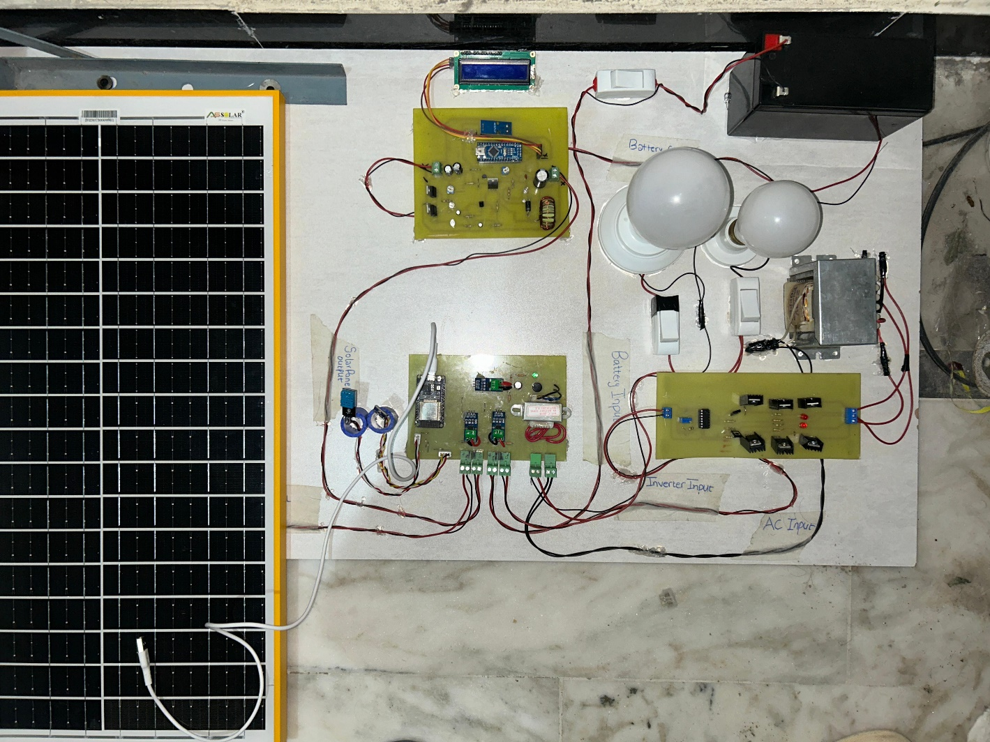
Circuit Diagrams
Complete System

Slide 18
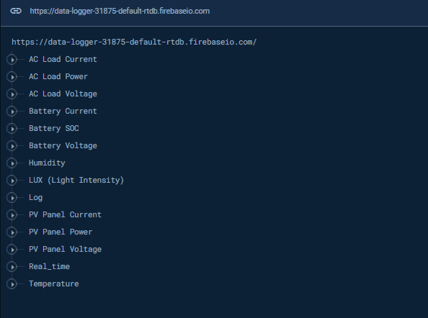
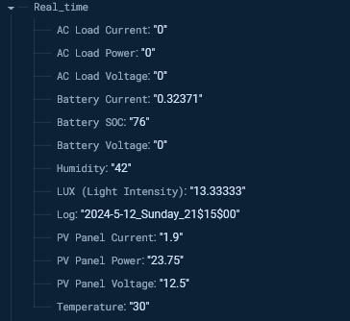
Circuit Diagrams
Cloud Storage

Slide 19
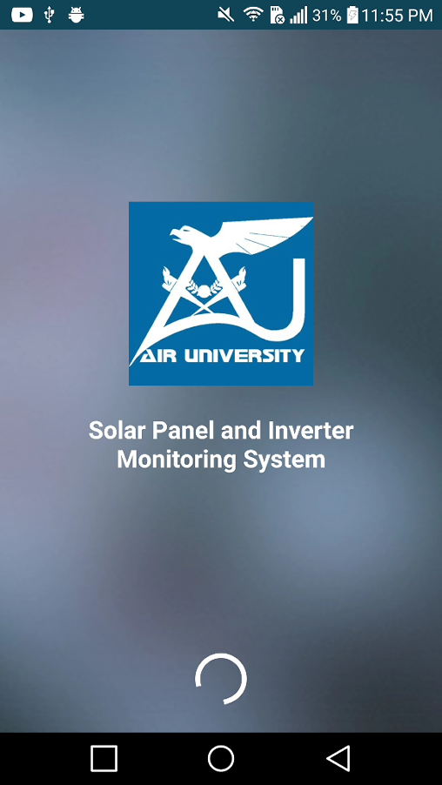
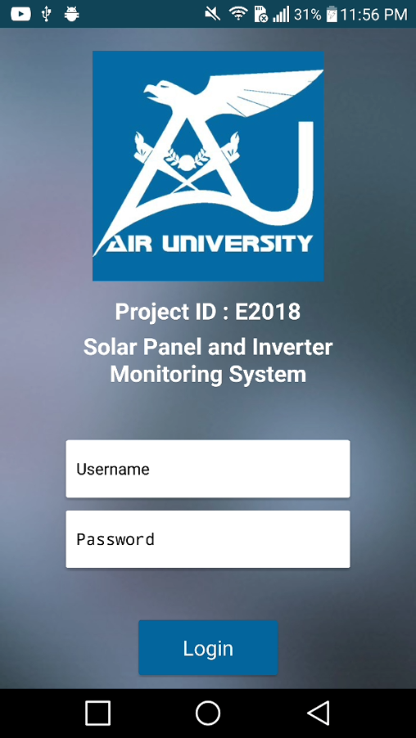
Mobile Application

Slide 20
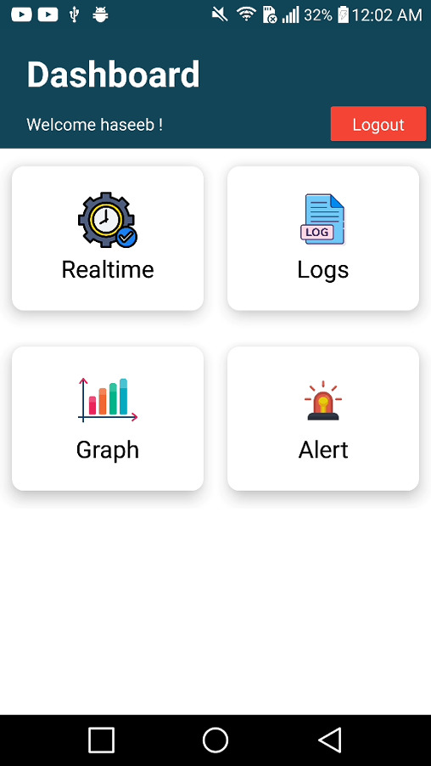
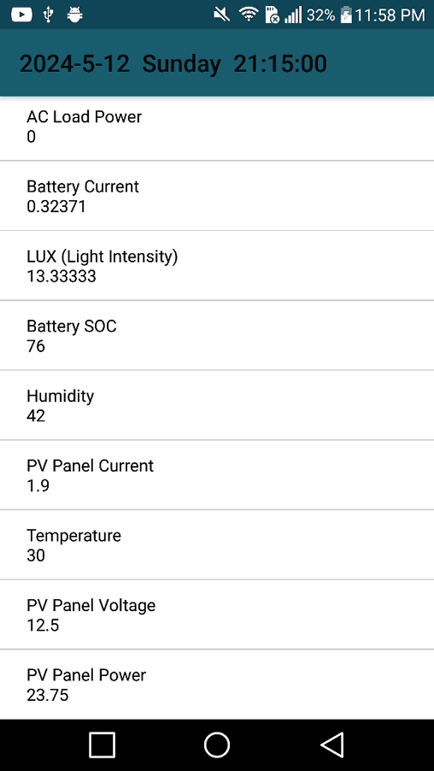
Mobile Application

Slide 21
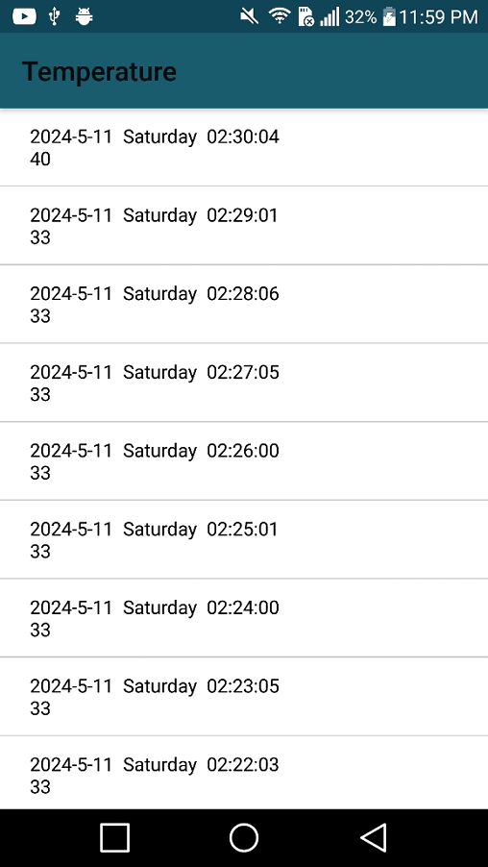
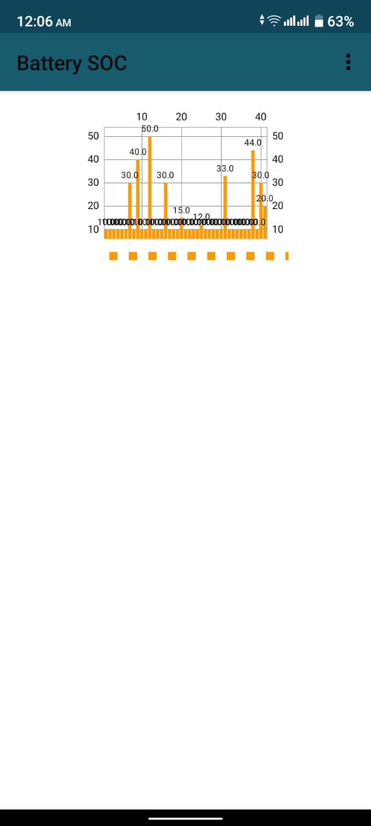
Mobile Application

Slide 22
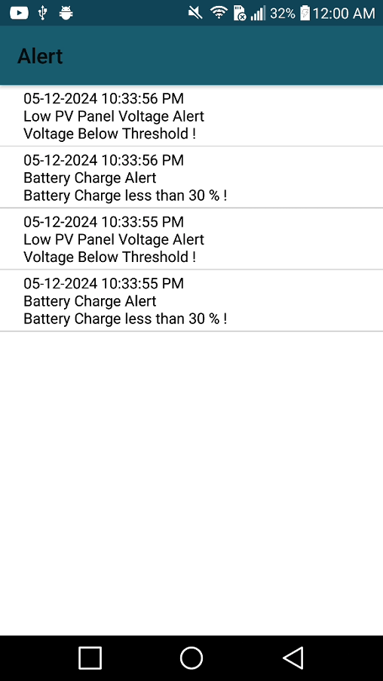
Mobile Application

Slide 23
Achievements/Completed Tasks
Designed, Tested and Manufactured an Inverter
Fully Functional Charge Controller
Constructed a sensing module
Successfully recorded data in firebase using ESP32
Created an App from Scratch using KODULAR
Displayed acquired data

Slide 24
Project Deliverables Status
Completed
Pending
Sensor Module integration
Fully Functional Hardware With Load
Mobile Application Development
Complete Project with Hardware and Software
Integration with Industry level hardware

Slide 25
Cost Analysis
Item | Cost
PV Panel (30Watts) | 5000/-
Battery/Charger | 7000/-
Inverter | 20000/-
Transformer | 2000/-
Charge Controller | 5000/-
Sensor Module | 5000/-
Miscellaneous | 20000/-

Slide 26
Conclusion
As per our deliverables mentioned and our accomplished goals, we agree that we have completed 85-90%
As displayed our project is in working condition and is prepared for the required demonstration.

Slide 27
References
International Renewable Energy Agency. (2021)
Majhi, Bijoyprakash. "Analysis of single-phase SPWM inverter." PhD diss., 2012.
Kumar, Aishwarya, et al. "An IOT based smart inverter." 2016 IEEE International Conference on Recent Trends in Electronics, Information & Communication Technology (RTEICT). IEEE, 2016.

